Slide 1
Graph-based Movie Recommender System
using Sentiment, Emotion Analysis of BERT
BERT
Graph Neural Network (GNN)
Presenter : Cheonsol Lee
Date : 2021.10.08
Notes:
안녕하세요.
BERT의 감성분석을 활용한 그래프 기반의 영화 추천시스템에 대한 연구를 말씀드리겠습니다.

Slide 2
1
Introduction
2
Related Work
3
Method
INDEX
4
Experiment
5
Results
6
Conclusion

Slide 3
1. Introduction
Thank you

Slide 4


1. Introduction – Motivation
Industry of Recommender System
User experience(UX) is required for personalized marketing.
When watching the movies, UX may be expressed as Sentiment/Emotion data.
Cinematic Experience (CX)
It means an unforgettable experience from watching a film.
User’s psychological information -> Sentiment/Emotion
Rational basis [1]
User’s feelings are reflected in the movie review.
There is a correlation between emotions about the movie reviews and satisfaction.
Emotional information can be used as personalized data.
Reference: [1] The impact of emotions on the helpfulness of movie reviews (JART 2015)

Slide 5
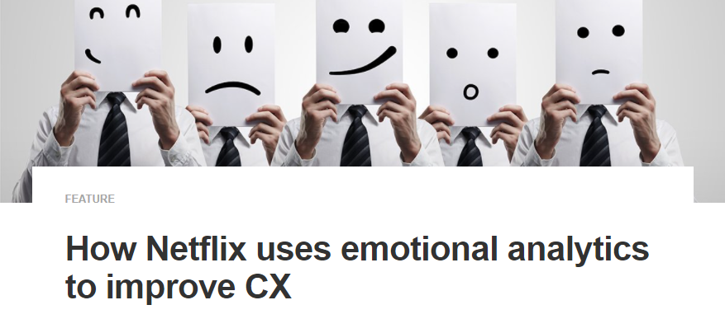

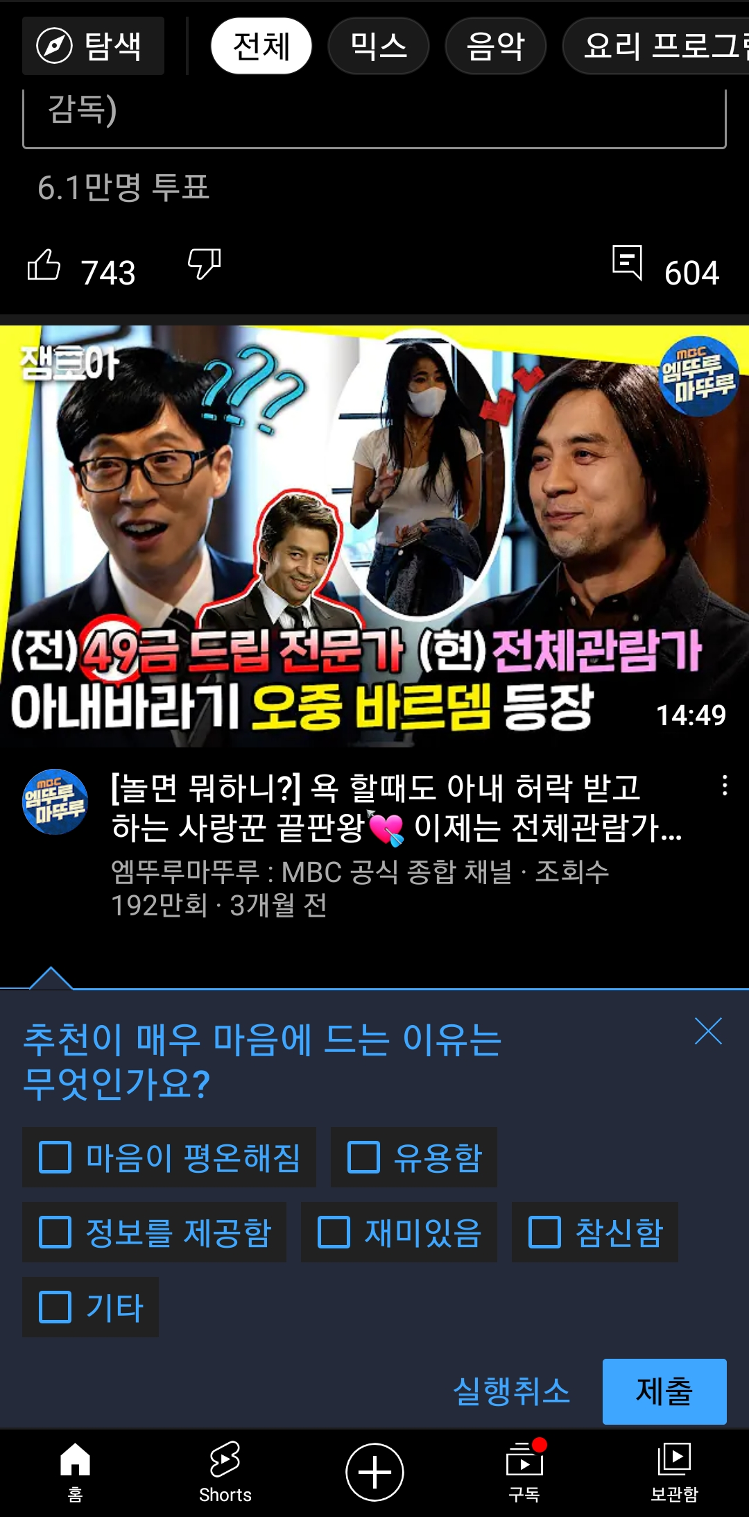
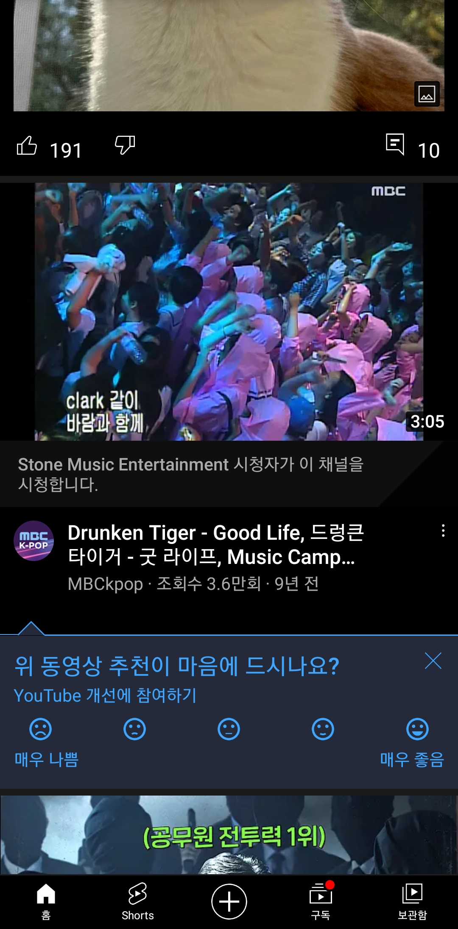

1. Introduction – Industrial Cases
Industrial Cases of Sentiment/Emotion for Personalized Recommendation
Netflix
Emotional analytics to improve CX
Emotional analytics enable businesses to obtain customer feedback.
YouTube
Report : Sentiment(5-levels), Emotion(part level)
<Technical report>
<Sentiment>
<Emotion>

Slide 6
1. Introduction – Research Question(RQ)
RQ1) Is it possible to improve performance by embedding an ordinal feature and
a categorical feature together in GCN?
RQ2) Which model performs the best rating prediction in recommender system algorithms?
RQ3) Is there a significant difference when sentiment and emotion are reflected in GCMC?
RQ4) Which embedding framework performs the best in GCMC?

Slide 7
2. Related Work
Thank you

Slide 8
2. Background
Definition
Sentiment divides user’s positive and negative feelings into 5-levels (ordinal)
Emotion divides user’s psychological feelings into 6-levels. (categorical)
0 | 1 | 2 | 3 | 4
Negative | Somewhat Negative | Neutral | Somewhat Positive | Positive
0 | 1 | 2 | 3 | 4 | 5
anger | fear | joy | love | sadness | surprise

Slide 9
2. Related Work (cont’d)
Emotion Analysis
[1] The impact of emotions on the helpfulness of movie reviews (JART 2015)
[2] Tensor-based tag emotion aware recommendation with probabilistic ranking. (KSII 2019)
[3] Item recommendation using tag emotion in social cataloging services. (ScienceDirect 2017)
[4] Using Affective Features from Media Content Metadata for Better Movie Recommendations (KDIR 2020)
Detect movie overviews’ implicit affective features like emotion and sentiment.
Strength: reflect dynamic information like user’s emotion and sentiment
Sentiment Analysis
[5] Review Sentiment-Guided Scalable Deep Recommender System (SIGIR 2018)
[6] How to improve the accuracy of recommendation systems: Combining ratings and review texts sentiment scores. (JIIS 2019)
[7] The impact of emotions on the helpfulness of movie reviews (JART 2015)
There is a correlation between emotions about the movie reviews and satisfaction.
[8] Integrating Collaborative Filtering and Sentiment Analysis : A Rating Inference Approach (ECAI workshop 2006)
Approach sentiment analysis with statistical techniques
[9] BERT 기반 감성분석을 이용한 추천시스템 (KCI 2021)
Comparing Emotional Analysis with ML/DL Techniques and Presenting the Performance of BERT
Limitation : rating inference was only carried out, and explainable recommendation is not possible.
[10] Movie Recommendation System Using Sentiment Analysis From Microblogging Data (IEEE transactions on computational social systems 2020)
Hybrid RS from collaborative filtering(CF) and content-based filtering(CBF) along with sentiment analysis

Slide 10
2. Related Work
Graph Neural Network
[10] Semi-Supervised Classification with Graph Convolutional Networks (ICLR 2017)
GCMC-based
[11] Graph Convolutional Matrix Completion (KDD 2018)
[12] Inductive Matrix Completion based on Graph Neural Networks (ICLR 2020)
[13] Inductive Matrix Completion Using Graph Autoencoder (CIKM 2021)
[14] AIRC: Attentive Implicit Relation Recommendation Incorporating Content Information for Bipartite Graphs (MDPI 2020)
Multi-layer graphs
[15] Community Detection in Multi-Layer Graphs: A Survey (SIGMOD 2015)
Link-prediction and GCN
[16] Link Prediction Based on Graph Neural Networks (NIPS 2018)
[17] Web Service Network Embedding based on Link Prediction and Convolutional Learning (IEEE Transactions on Services Computing)
Bi-partite graph
[18] Bipartite graph partitioning and data clustering (CIKM 2001)
[19] Metadata-Based Collaborative Filtering Using K-Partite Graph for Movie Recommendation (EDB 2012)
[20] Domain Knowledge-Based Link Prediction in Customer-Product Bipartite Graph for Product Recommendation (IJIT & DM 2019)

Slide 11
3. Method
Thank you

Slide 12
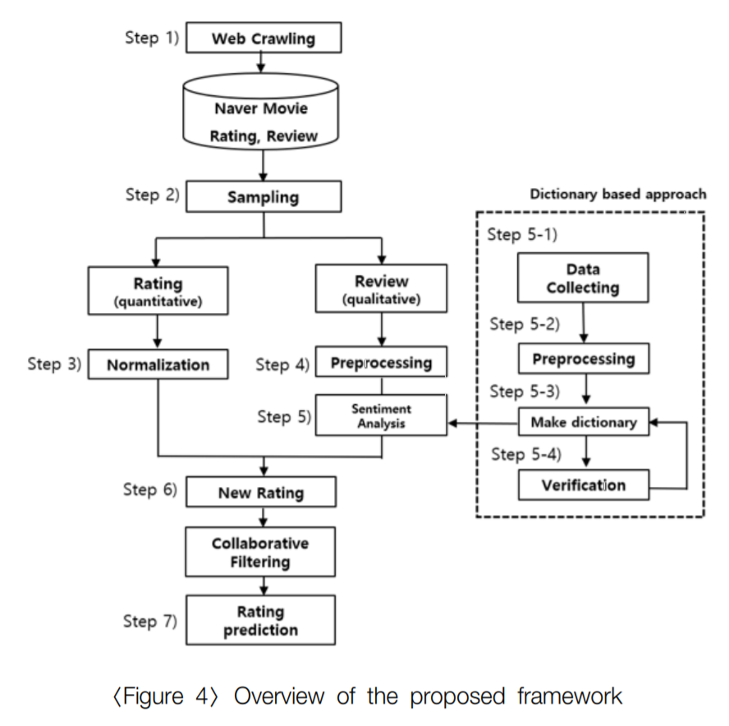
3. Method
Web Crawling
Movie Database
Sampling
Review
Rating
Review
BERT
BERT
Normalization
Sentiment / Emotion
Sentiment
Emotion
Multi-layer graphs
embedding
Graph Model
Rating Prediction

Slide 13
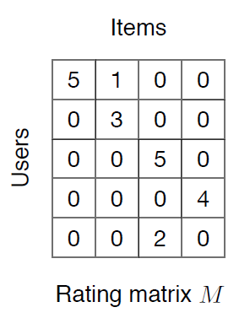
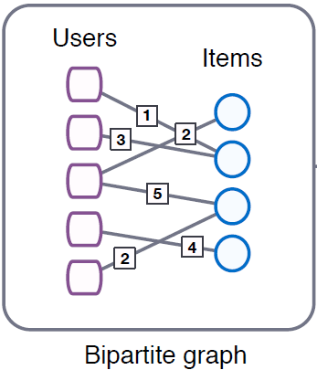
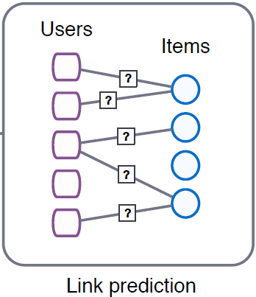
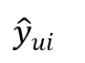
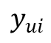
3. Framework – Baseline
User features: top_critic, publisher_name
Item features: title, year, genres
Target
$$y_{ui}$$
User embedding
GCMC
Encoder
GCMC
Decoder
$${\hat{y}}_{ui}$$
Prediction
Item embedding
Reference: [11] Graph Convolutional Matrix Completion (KDD 2018)
Notes:
그래프를 단순 합으로 결합
Multi-layer로 구성하여 GNN 학습

Slide 14
3. Framework – Baseline + IDEA concept
Target
$$y_{ui}$$
M | R | U
0 | 3 | 1
1 | 2 | 1
2 | 1 | 2
User embedding
GCMC
Encoder
GCMC
Decoder
$${\hat{y}}_{ui}$$
Prediction
Item embedding
(Rating)
Type1
Type2
Type3
Notes:
그래프를 단순 합으로 결합
Multi-layer로 구성하여 GNN 학습

Slide 15
3. Framework1 – Before Encoding
M | R | U
0 | 3.5 | 1
1 | 4.7 | 1
2 | 1.3 | 2
Target
$$y_{ui}$$
(Rating)
M | R | U
0 | 3 | 1
1 | 2 | 1
2 | 1 | 2
User embedding
GCMC
Encoder
GCMC
Decoder
$${\hat{y}}_{ui}$$
Prediction
Item embedding
(Sentiment)
M | R | U
0 | 5 | 1
1 | 2 | 1
2 | 3 | 2
(Emotion)
Notes:
그래프를 단순 합으로 결합
Multi-layer로 구성하여 GNN 학습

Slide 16
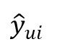
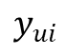
3. Framework2 – After Encoding
M | R | U
0 | 3.5 | 1
1 | 4.7 | 1
2 | 1.3 | 2
User embedding
GCMC
Encoder
Target
Item embedding
$$y_{ui}$$
(Rating)
M | R | U
0 | 3 | 1
1 | 2 | 1
2 | 1 | 2
User embedding
User embedding
GCMC
Encoder
GCMC
Decoder
$${\hat{y}}_{ui}$$
Prediction
Item embedding
Item embedding
(Sentiment)
M | R | U
0 | 5 | 1
1 | 2 | 1
2 | 3 | 2
User embedding
GCMC
Encoder
[Aggregation Functions]
Mean
Sum
Avg
Concat
Item embedding
(Emotion)
Notes:
그래프를 단순 합으로 결합
Multi-layer로 구성하여 GNN 학습

Slide 17
3. Framework3 – After Decoding
M | R | U
0 | 3.5 | 1
1 | 4.7 | 1
2 | 1.3 | 2
User embedding
GCMC
Encoder
GCMC
Decoder
Target
Item embedding
$$y_{ui}$$
(Rating)
M | R | U
0 | 3 | 1
1 | 2 | 1
2 | 1 | 2
User embedding
GCMC
Encoder
GCMC
Decoder
$${\hat{y}}_{ui}$$
Prediction
Item embedding
(Sentiment)
M | R | U
0 | 5 | 1
1 | 2 | 1
2 | 3 | 2
User embedding
GCMC
Encoder
GCMC
Decoder
Item embedding
(Emotion)
Notes:
그래프를 단순 합으로 결합
Multi-layer로 구성하여 GNN 학습

Slide 18
3. Framework4 – Knowledge Distillation
M | R | U
0 | 3.5 | 1
1 | 4.7 | 1
2 | 1.3 | 2
A_{user}
Prediction
GCMC
Encoder
GCMC
Decoder
$${\hat{y}}_{ui}$$
A_{item}
(Rating)
M | R | U
0 | 3 | 1
1 | 2 | 1
2 | 1 | 2
B_{user}
GCMC
Encoder
$$y_{ui}$$
Target
B_{item}
(Sentiment)
M | R | U
0 | 5 | 1
1 | 2 | 1
2 | 3 | 2
C_{user}
GCMC
Encoder
Train Loss : |A-B| + |A-C| + |Prediction-Target|
Testset : only rating dataset (Cover: rating O, review X)
C_{item}
(Emotion)
Notes:
그래프를 단순 합으로 결합
Multi-layer로 구성하여 GNN 학습

Slide 19
3. Framework5 – Features Embedding
Target
$$y_{ui}$$
M | R | U
0 | 3 | 1
1 | 2 | 1
2 | 1 | 2
User embedding
GCMC
Encoder
GCMC
Decoder
$${\hat{y}}_{ui}$$
Prediction
Item embedding
(Rating)
1 | 0 | 0 | 0 | … | 1
0 | 1 | 0 | 0 | … | 0
1 | 0 | 0 | 0 | … | 0
1 | 0 | 0 | 1 | … | 1
0 | 0 | 0 | 0 | … | 1
User features: top_critic, publisher_name
Item features: title, year, genres
Sentiment
Emotion
Sparse Matrix
Notes:
그래프를 단순 합으로 결합
Multi-layer로 구성하여 GNN 학습

Slide 20
4. Experiment
Thank you

Slide 21
4. Experiment – dataset (Movie)
Dataset
Period : 1914.06.01 ~ 2020.10.31
Link : https://www.kaggle.com/stefanoleone992/rotten-tomatoes-movies-and-critic-reviews-dataset
Data
File name | Dimension | Columns
Movie data | (17713, 22) | 'rotten_tomatoes_link', 'movie_title', 'movie_info', 'critics_consensus', 'content_rating', 'genres', 'directors', 'authors', 'actors', 'original_release_date', 'streaming_release_date', 'runtime', 'production_company', 'tomatometer_status', 'tomatometer_rating', 'tomatometer_count', 'audience_status', 'audience_rating', 'audience_count', 'tomatometer_top_critics_count', 'tomatometer_fresh_critics_count', 'tomatometer_rotten_critics_count'
Review data | (1048576, 8) | rotten_tomatoes_link, critic_name, top_critic, publisher_name, review_type, review_score, review_date, review_content
Rating | Review | Amount | Rate
O | O | 758,709 | 67%
X | O | 305,502 | 27%
O | X | 65,372 | 5%
X | X | 434 | 0.03%

Slide 22
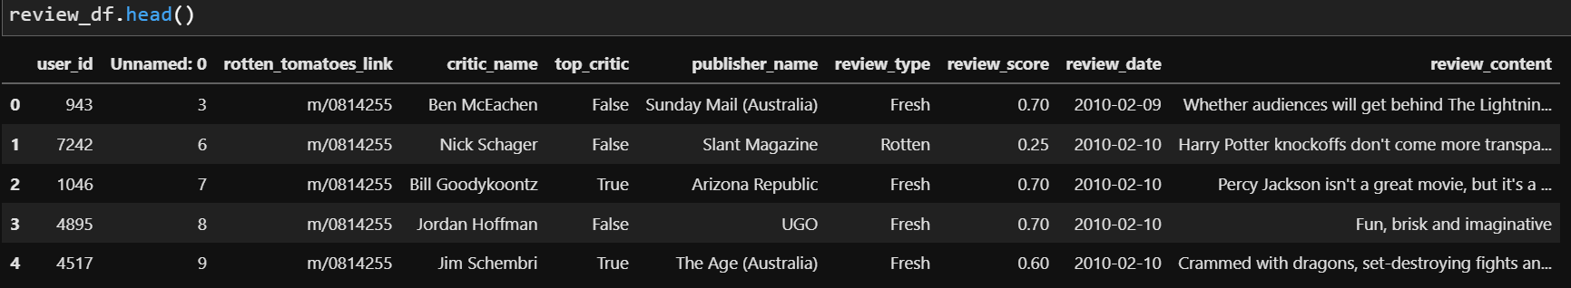
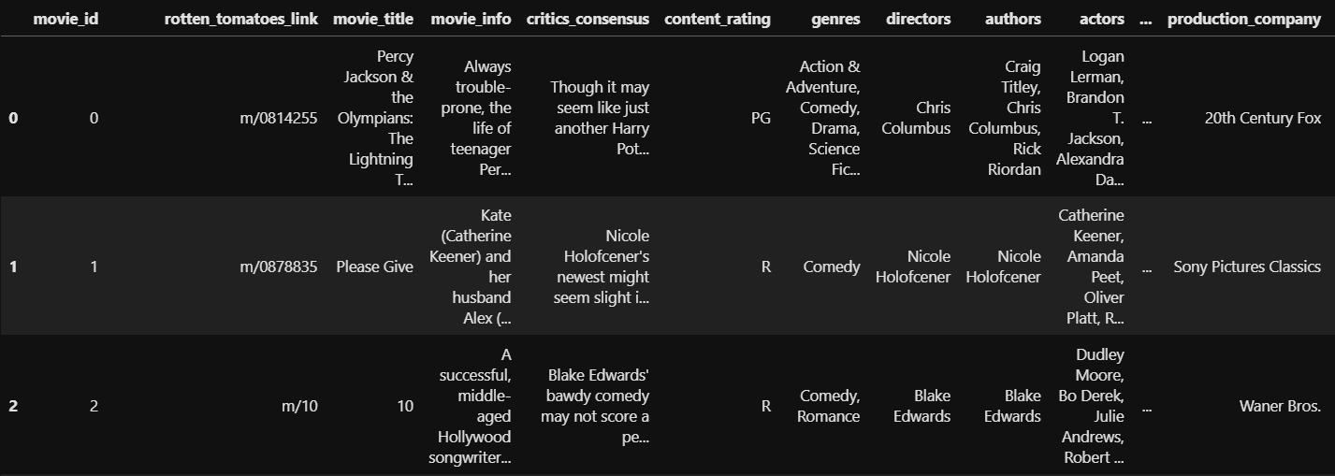
4. Experiment – dataset (Movie)
Dataset
Rating matrix
Group : critic_name, top_critic, publisher_name
The number of users : 9,794
Movie matrix
The number of movies: 17,614

Slide 23
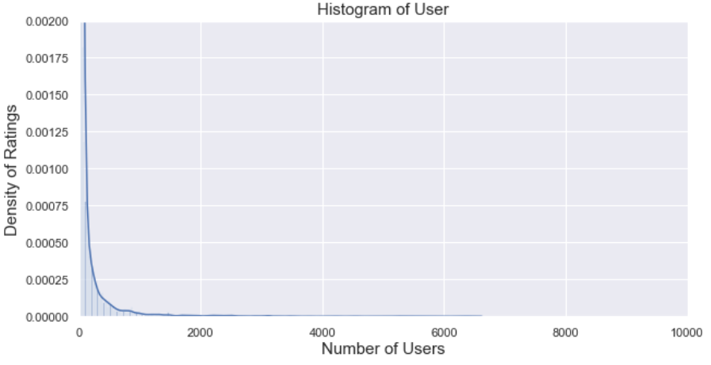
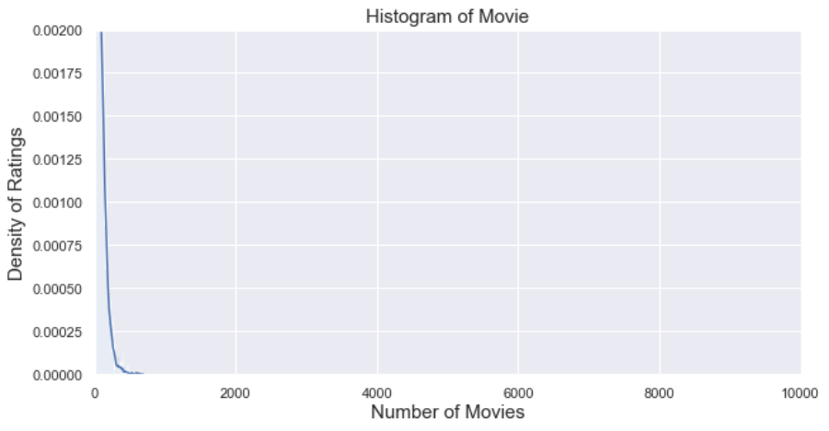
4. Experiment – dataset (Movie)
Histogram
Group: User, Movie
Train/test rate = 9 : 1 (by timestamp)
Number: user_id(850), movie_id(6,805)
Exclude cold-start problem (user, item)
Range | User | Movie
Total | 9,794 | 17,614
< 3 | 3,552 (36%) | 993 (6%)
< 5 | 4,653 (48%) | 2,892 (16%)
>= 20 | 2,994 (31%) | 8,110 (46%)
>= 500 | 345 (4%) | 13 (0%)
Reviews >= 20
<User>
<Movie>

Slide 24
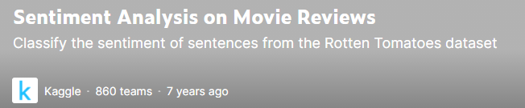
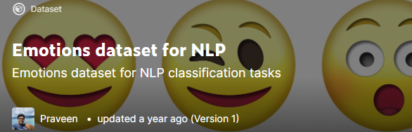
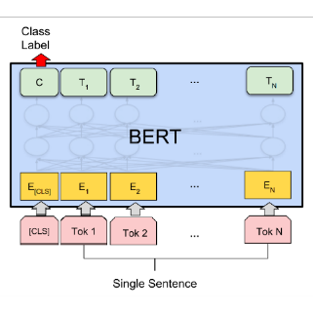
4. Experiment – dataset (sentiment, emotion)
Sentiment, Emotion dataset
Training data for BERT model in Kaggle
Sentiment
Emotion
Feature generating/augmentation using BERT fine-tuning
0 | 1 | 2 | 3 | 4
Negative | Somewhat Negative | Neutral | Somewhat Positive | Positive
0 | 1 | 2 | 3 | 4 | 5
anger | fear | joy | love | sadness | surprise
Review data
Result
U | E | M
0 | 1 | 1
1 | 3 | 1
2 | 2 | 2
Uma Thurman as Medusa, the gorgon with a coiffure of writhing snakes and stone-inducing hypnotic gaze is one of the highlights of this bewitching fantasy
Sentiment, emotion value
(graph)

Slide 25
4. Experiment – Table
Result
Graph type : Rating, Sentiment, Emotion + Meta informaion
Data : 60% (rating, review)
Ideal result
Type | Method | RMSE/MAE | Data
Baselines | CF MF: SVD, SVD++ | Low | Rating
Graph (in general) | GCMC | Middle | Rating
Graph (our model) | GCMC + “novelty” | High | Rating
 |  |  | Rating + Sentiment
 |  |  | Rating + Emotion
 |  |  | Rating + Sentiment + Emotion

Slide 26
5. Results
Thank you

Slide 27
5. Results – Table
16 Experiments
Algorithm | RMSE | RANK
SVD | 0.8469 | 6
SVDpp | 0.8270 | 5
SlopeOne | 0.9273 | 14
NMF | 0.9056 | 10
NormalPredictor | 1.4758 | 17
KNNBasic | 0.8726 | 9
KNNBaseline | 0.8519 | 8
KNNWithMeans | 0.9232 | 13
KNNWithZScore | 0.9168 | 12
BaselineOnly | 0.8485 | 7
CoClustering | 0.9538 | 15
GCMC(Feature X) - regression | 0.9637 | 16
GCMC(Feature O) - regression | 0.9148 | 11
GCMC(Feature X) | 0.8142 | 4
GCMC(Feature O) | 0.7176 | 3
GCMC(Feature O, T=0.8) | 0.7127 | 2
GCMC(Feature O, framework1) | 0.7091 | 1
Surprise
GCMC

Slide 28
5. Results – RMSE Graph

Slide 30
Model type | Best RMSE
GCMC(feature O, sentiment) | 0.8059
GCMC(feature O, emotion) | 0.8065
GCMC(feature O, emotion, sentiment) | 0.807
GCMC((feature O, rating only) | 0.811
GCMC(feature X, rating only) | 0.8132
SVDpp | 0.8265
GCMC(feature X, emotion, sentiment) | 0.8307
GCMC(feature X, emotion) | 0.8326
GCMC(feature X, sentiment) | 0.8365
SVD | 0.8493
KNNWithMeans(itme-based) | 0.8818
KNNWithMeans(user-based) | 0.9233

Slide 31
6. Conclusion
Thank you

Slide 32
6. Conclusion
Cinematic Experience(CX) can be used for personalized recommendations.
Recommendations reflecting sentiment/emotion data improve rating prediction.
The graph reflects the relational information between users and items.
GNN-based recommendation is better than traditional methods.

Slide 33
7. Feedback
Thank you

Slide 34
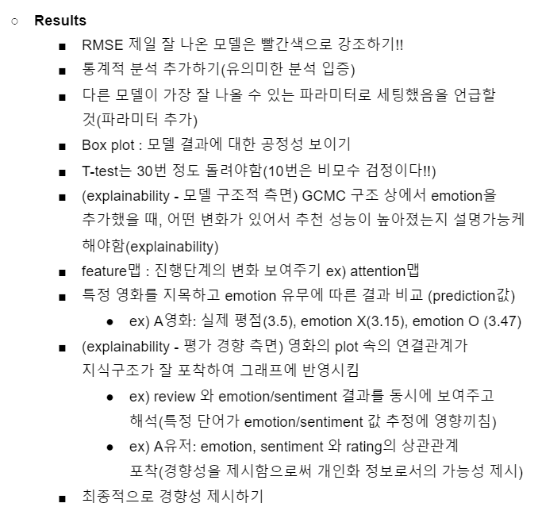
Feedback (이문용 교수님)

Slide 35
Feedback (한동희)
Spectral : 전체 그래프를 본다
GCMC
Spatial : 서브 그래프를 추출하여 특정 영역만을 가지고 추론 (GCN: 연결된 노드만 메시지 패싱)
서브그래프로 쪼개서 함
배치를 쪼개면서 학습해야 장점이 많다.
모델의 한계: 전체 그래프를 넣지 말고 서브 그래프로 넣으면 좋을 것이다.
Future work

Slide 36
Thank you
Thank you

Slide 37
Appendix
Thank you

